Slide 1

Network Services Business
STL Corporate Deck 2019
www.sterlitetech.com

Slide 2


Network Services
About STL
Network Services Business
beyond tomorrow
Our Offerings
Our Experience & Credentials

Slide 3
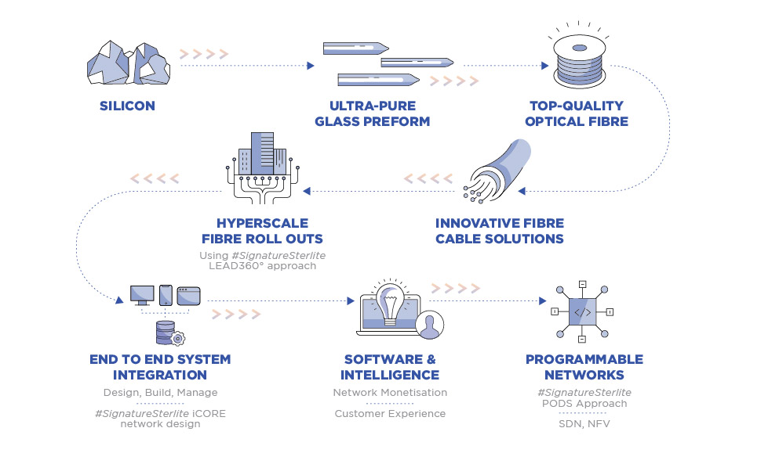



We are STL, a unique silicon to software company, unparalleled in the world
CONNECTIVITY
SOLUTIONS
NETWORK SERVICES
NETWORK
SOFTWARE
3

Slide 4
We have the experience and the expertise
All-Stack Capability
Only company in the world
Integrated across the network stack
Global Experience
43% revenue from exports
Partnering with 7 of Top 10 Telcos globally
Collaborating with Top 2 Cloud companies
beyond tomorrow
Technology Focused
271 Patents
3 Innovation Centres
IITs, Rutgers Academia Connect
End to End Solutions
Mobility | Access | Long Haul Connectivity
Network Modernization | Data Centre

Slide 5
Network Services
About STL
Network Services Business
beyond tomorrow
Our Offerings
Our Experience & Credentials

Slide 6
STL Network Services
Your Trusted Partner
For Data Networks
That go beyond tomorrow

Slide 7
What do we do
Your Networks are
1
Hyperscale Converged Networks
We think, design and bring to life, Data Networks that synergize the potential of wireless & wireline technologies and achieve massive scale with amazing simplicity
Our Business
We do it with our, End to End Network solutions portfolio
Create new infographic for hyper scale converged NW

Slide 8
What do we do
1
Your Networks are
Hyperscale Converged Networks
We think, design and bring to life, Data Networks that synergize the potential of wireless & wireline technologies and achieve massive scale with amazing simplicity
Intelligent Digital Ecosystem
We do it with our End to End Network Solutions Portfolio
We think beyond connectivity. We think about Digital of Everything to solve tough problems and to transform lives. Our intelligent applied technology solutions are delivering immense value to our customers
Our Business
2
Your Digital Ecosystem is
We do it with our, Design-led System Integration Services

Slide 9
Truly end-to-end
Hyperscale Converged Networks
Intelligent Digital Ecosystem
Long haul - Core Network | Access Connectivity | Active Transport
Inter-city, Intra-city | Wireless backhaul, Front haul | MPLS, DWDM , Advanced transport technologies
Hyperscale FR (powered by LEAD360o) | FTTx Mantra (powered by 5i)
- | DNA (powered by iCORE)
Data Center | Security | Applications
Cloud and on prem Service | Complete Security - convergence of physical and cyber | Big data Network analytics, IoT and AI platforms
Massive connectivity solutions – Data centre interconnect & - Design,Build | Physical security with Sensron + Cyber security with Sensron dot | STL Garv Supercomputer for villages
NEXT Networks
( E2E Network modernisation)

Slide 10
Truly end-to-end
Hyperscale Converged Networks
Intelligent Digital Ecosystem
End to End Network solutions portfolio
Design-led System Integration Services
Long haul - Core Network | Access Connectivity | Active Transport
Inter-city, Intra-city | Wireless backhaul, Front haul | MPLS, DWDM , Advanced transport technologies
Hyperscale FR (powered by LEAD360o) | FTTx Mantra (powered by 5i)
- | DNA (powered by iCORE)
Data Center | Security | Applications
Cloud and on prem Service | Complete Security - convergence of physical and cyber | Big data Network analytics, IoT and AI platforms
Massive connectivity solutions – Data centre interconnect & - Design,Build | Physical security with Sensron + Cyber security with Sensron dot | STL Garv Supercomputer for villages
NEXT Networks
( E2E Network modernisation)

Slide 11
Truly end-to-end
Our expertise- differentiated
End to End offerings
Hyperscale Converged Networks
Intelligent Digital Ecosystem
Long haul - Core Network | Access Connectivity | Active Transport
Inter-city, Intra-city | Wireless backhaul, Front haul | MPLS, DWDM , Advanced transport technologies
Hyperscale FR (powered by LEAD360o) | FTTx Mantra (powered by 5i)
- | DNA (powered by iCORE)
Data Center | Security | Applications
Cloud and on prem Service | Complete Security - convergence of physical and cyber | Big data Network analytics, IoT and AI platforms
Massive connectivity solutions – Data centre interconnect & - Design,Build | Physical security with Sensron + Cyber security with Sensron dot | STL Garv Supercomputer for villages
NEXT Networks
( E2E Network modernisation)

Slide 12
we
So what do
do Differently?

Slide 13
With constant research & innovation….
we
CENTER FOR SMARTER NETWORK
we
DESIGN
1
DESIGN
Technology and applied research on smarter networks of the future
To solve
To solve
SNL – Next Gen Access Technology
DELIVER
2
Carrier grade network – Development of Next Gen converged access network
To delight
3
COE – CENTER OF EXCELLENCE
CREATE VALUE
Disruptive innovation to develop first of its kind fibre deployment approaches
To transform
4
STL TECH ACADEMY
Enhancing network creation ecosystem through certified technical training

Slide 14
With STL Way of execution…
STL way of Execution
we
DESIGN
Robust Planning approach (driven by everything survey and algorithm based planning)
Superior project management (driven by industry standard Playbooks & processes alongwith E2E digital platform for program management)
To solve
DELIVER
To delight
Delivering through ecosystem of specialist (Competent specialist at every level of Network creation value chain)
Scientifc partner management approach (driven by systematic and performance driven partner life cycle management)
CREATE VALUE
To transform

Slide 15
With our tenacious problem solving…
1
2
we
DESIGN
To solve
World’s first EXABYTE network with fastest scale-up
World’s largest intrusion proof network in the toughest terrain
DELIVER
To delight
3
4
CREATE VALUE
To transform
Massive network overhaul of legacy naval network
Digital inclusion for 45 Lakh rural homes

Slide 16
Network Services
About STL
Network Services Business
beyond tomorrow
Our Offerings
Our Experience & Credentials

Slide 17
Truly end-to-end
Hyperscale Converged Networks
Intelligent Digital Ecosystem
End to End Network solutions portfolio
Design-led System Integration Services
Long haul - Core Network | Access Connectivity | Active Transport
Inter-city, Intra-city | Wireless backhaul, Front haul | MPLS, DWDM , Advanced transport technologies
Hyperscale FR (powered by LEAD360o) | FTTx Mantra (powered by 5i)
 | DNA (powered by iCORE)
Data Center | Security | Applications
Cloud and on prem Service | Complete Security - convergence of physical and cyber | Big data Network analytics, IoT and AI platforms
Massive connectivity solutions – Data centre interconnect & - Design,Build | Physical security with Sensron + Cyber security with Sensron dot | STL Garv Supercomputer for villages
1
2
5
6
8
7
3
4
NEXT Networks
( E2E Network modernisation)

Slide 18
STL NSB
End-End
Network Solutions

Slide 19
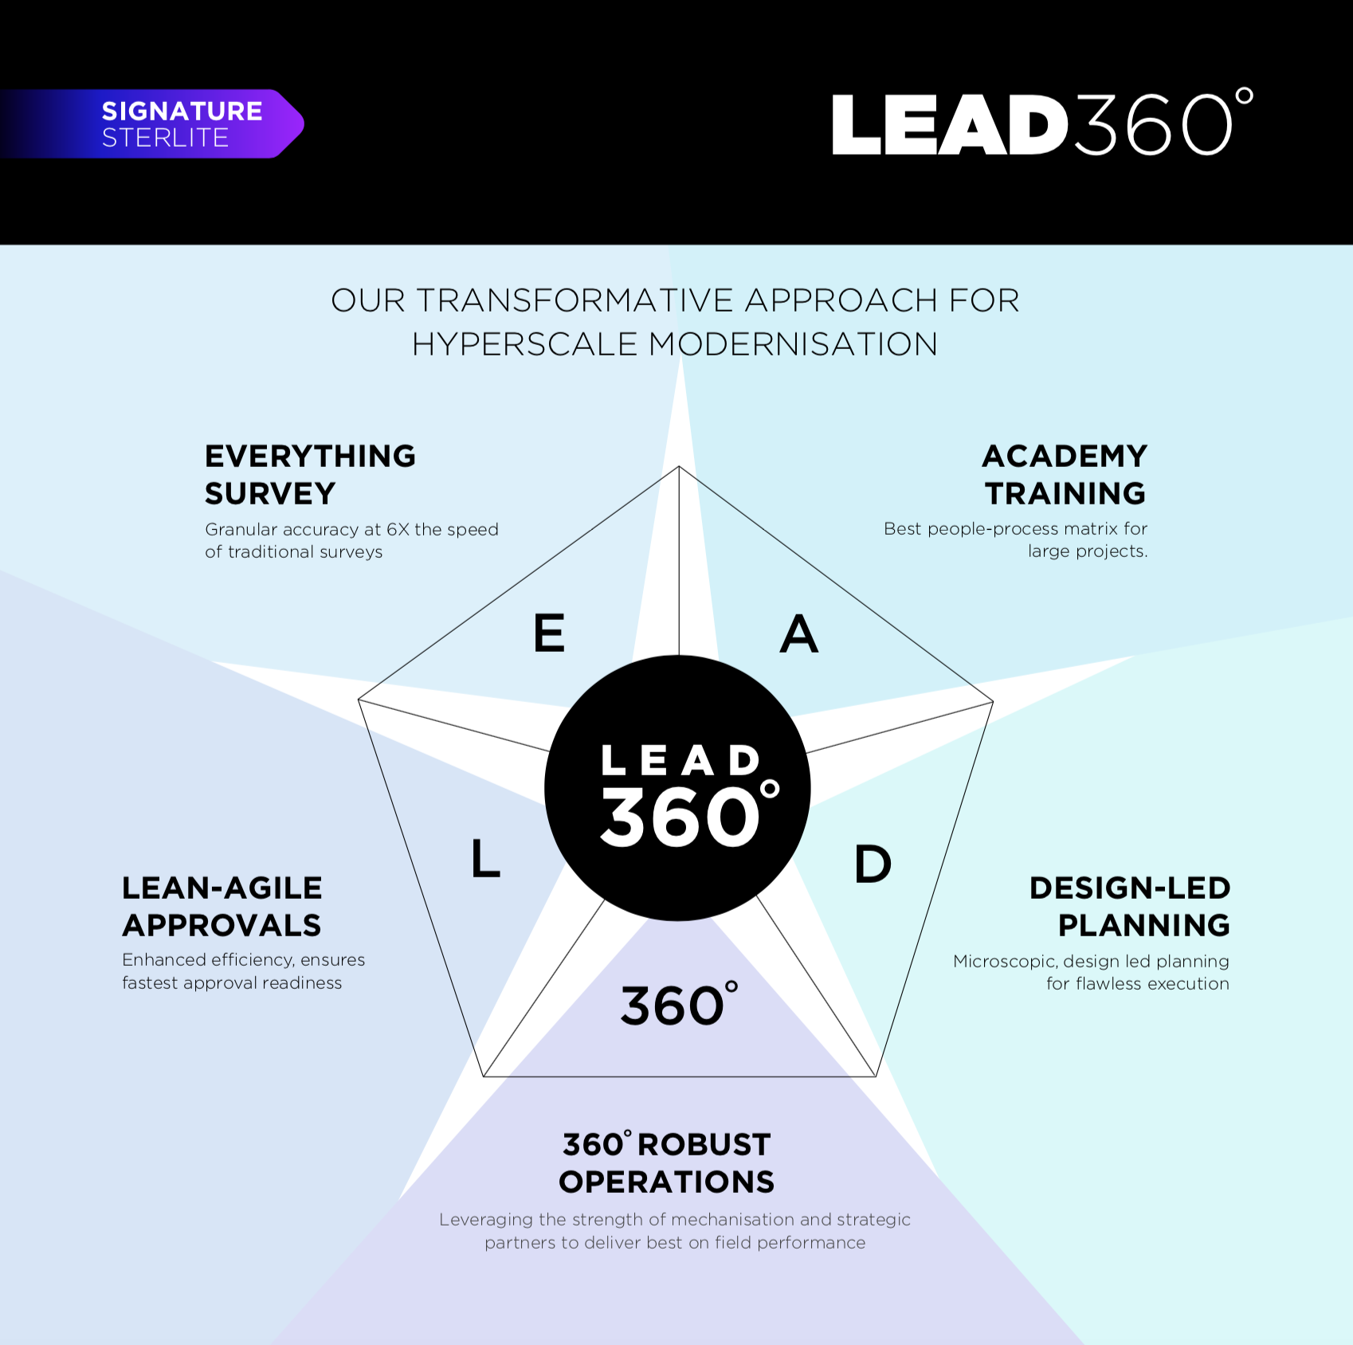
Hyperscale fibre roll outs with LEAD360º
Offering
1
2X speed of deployment
50% less manpower for survey & supervision
FTR improving network life
Enhanced network performance
Seamless Roll outs with Lead360º
Back

Slide 20


Fibre to the eXponential with FTTx Mantra
Offering
2
End to end solution
Simplified field operations
Hyperscale FTTx
SD- Access solution
Immense value for CSPs Power of 1 solution
DISAGGREGATED
APPROACH
INTEGRATED PLAY
BRINGING IT ALL
TOGETHER AS
Company A
Intelligent Software Solution Billing & Revenue Management / Intelligent Data Lake
SOFTWARE
Company B
END-TO-END
SOLUTION
Innovative
Virtualisation SDN/NFV
SD ACCESS SOLUTION
Company C
Inclusive Fibre Roll-outs
LEAD 360
FIBRE ROLLOUT
LEAD
360
Company D
Integrated Network Design Algorithmic design | Flattened networks
FTTH KITS
Company E
Ingenious Products
Fibre | Cable | Kits
FIBRE & CABLE SOLUTIONS
Back

Slide 21

Design Networks that Accelerate with iCORE
Offering
3
STL’s DNA Paradigm shift in network design
Centralized Planning

Scale solved
Latency solved
Agility solved
Uptime solved
Cost solved
One Backbone

Integrated

Re-Use Existing Infra

Everything Survey

Back

Slide 22









E2E Network Modernisation with NEXT NETWORKS
Offering
4
STL NEXT Networks
All that you need for your digital transformation
APPLICATION LAYER
EXCELLENCE AT EACH NETWORK LAYER
APPLICATION TP, CENTREX
BIG DATA
VIRTUALISATION
ARTIFICIAL INTELLIGENCE
DATA CENTRE
LAYER
iCORE network design
LEAD360^{O} roll outs
PODS – Programmability
& Intelligence
SDN / NFV
Data centres , NOC, SOC
Command & control centre
IoT
Strategic partners
DATA CENTRE SERVER & STORAGE
COMMAND & CONTROL CENTRE
NETWORK
LAYER
CORE (SUPER CORE, CORE, EDGE LAYERS) IP MPLS
DISTRIBUTION/ METRO DWDM
END USER
LAYER
ACCESS LAYER GPON, MSAN
Back

Slide 23
Access connectivity with FWA
To be added once ready

Slide 24
STL NSB
Design-Led
System Integration

Slide 25
Massive connectivity solution for your Data Centre needs
To be added
Back

Slide 26
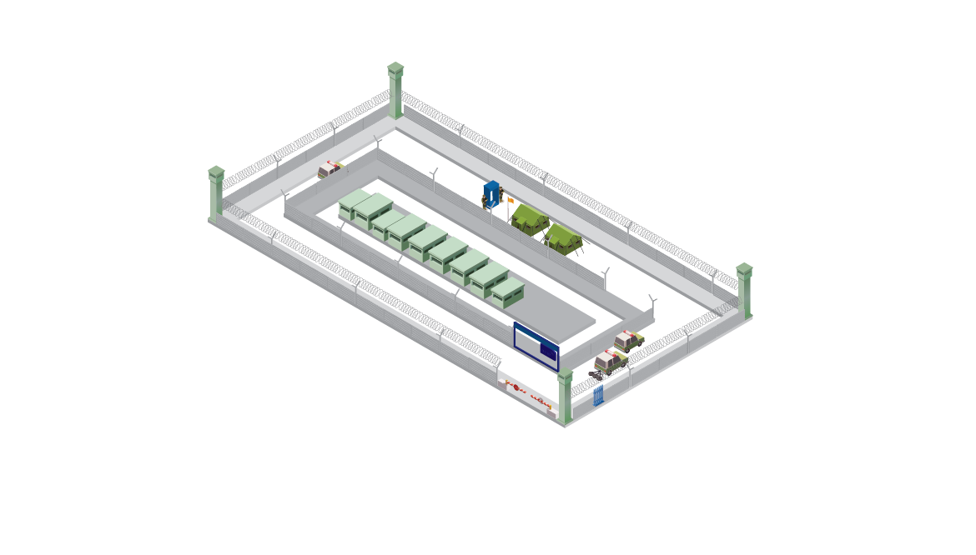
Everything critical ‘secured’ with Sensron+
Offering
5
Signature STL ecosystem design
^{All that you need for secure} ^{infrastructure}
Fibre and hybrid Sensing
Intrusion-proof Network
Full suite of Security
Security Applications
CCC
PERIMETER LIGHT & CAMERAS
VISITOR MANAGEMENT SYSTEMS
DIDS WITH FOCUSED SPOT LIGHT & CAMERA
PEDESTRIAN SANITIZATION METAL DETECTORS – DOOR FRAME & HANDHELD, BAGGAGE SCANNER
MICRO-UAV
PROTECTIVE GEAR
V/UHF COMM SET
RUGGEDISED TABS
ANTI CLIMB FENCE, CONCERTINA COIL, Y BEAMS
MOBILE CCC
FIBRE OPTIC FENCE SENSOR CABLE
CHIN LINK FENCING
Y BEAMS & CONCERTINA COILS ON PERIMETER WALL
GROUND LAID CONCERTINA
VEHICLE SANITIZATION UVSS,SLIDING GATES, BOLLARDS & TYRE SHREDDERS
Security Applications: Cameras, Search lights, RADAR, LIDAR, Smart power fence, VMS, Under vehicle surveillance, Ruggedized tabs, U/VHF devices, Unarmed aerial vehicle
MOBILE BULLET SENTRY POST
GATE WITH RFID
INTEGRATION OF POWER FENCING
Back

Slide 27
Cybersecurity with Sensron dot
To be added
Back

Slide 28
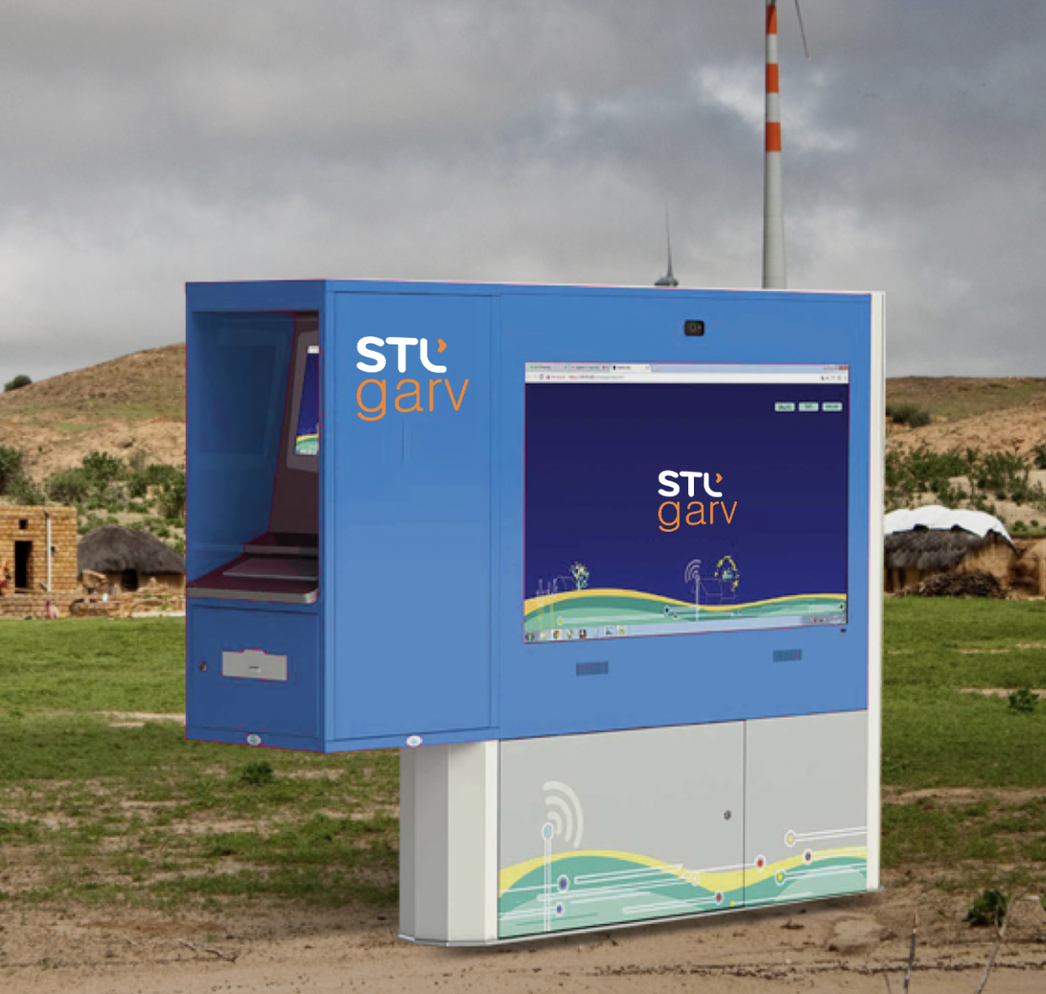
Transforming rural communities with STL Garv
Offering
6
This is a revolutionary service !!
Innovation where it matters Applied infrastructure solution which with use-cases that matter
Supercomputer kiosk
Speech to email conversion
E-tutoring
Telemedicine
Swachh sense
Smart surveillance & lighting
Back

Slide 29
Network Services
About STL
Network Services Business
beyond tomorrow
Our Offerings
Our Experience & Credentials

Slide 30



We solved Customer Challenges
Incumbent Telco
Disruptive Telco
Digital Inclusion
THE GOAL
OUR SOLUTION
Retain leadership, by leveraging existing network assets to create a Agile infrastructure capable of dynamic service allocation for diverse needs
Market Leader in India
CHALLENGE
420 Mn Subscriber
base
RESULTS
Optimising the existing NW Assets
Integration of highest magnitude
Incremental CAPEX resulting in gradual transition to a future ready network
Future ready Hybrid access network architecture
NW Integration to optimize cost of operations
Detailed Network transition roadmap in line with their CAPEX plans

Slide 31


We solved Customer Challenges
Incumbent Telco
Disruptive Telco
Digital Inclusion
THE GOAL
OUR SOLUTION
World’s first Exabyte network
Become the no.1 Telco in India backed by a robust future ready network infrastructure capable of delivering next-gen digital services
Disruption at its best
CHALLENGE
RESULTS
Massive scale of deployment in a short timeframe
High pressure on time to market
Projects pan India leading to very high complexity
2X
50%
FTR
Network Integration to optimize cost of operations
Speed of deployment
Manpower for supervision and survey
Improving Network life Better TCO

Slide 32



We solved Customer Challenges
Incumbent Telco
Disruptive Telco
Digital Inclusion
THE GOAL
OUR SOLUTION
Part of
BharatNet Program
Ubiquitous access of high speed broadband in the state of Telangana – Only Citizen network in India connecting each and every household with full fibre Network
Large scale
digital inclusion initiative
CHALLENGE
RESULTS
Deployment of 200K Kms and 0.5 Mn HP at an Aggressive timeline of2 years
Optimize capex to rollout scalable MPLS network.
Involved multiple technologies like MPLS,DWDM,GPON and Wireless
Futuristic/ SDN ready state wide network
Connecting 2.5 Lakh Gram Panchayats
Infrastructure synergies ~ Enabling rapid & reduced cost of deployment

Slide 33



And became the most trusted Data Network Solutions Provider
NFS
Trusted technology partner for the fastest growing Telco in the world
Trusted technology partner for the fastest growing Telco in the world
The world’s largest intrusion-proof smarter network in one of the most rugged terrains in the world
Building an Avant-garde digital communications network
for the Indian navy

Slide 34

www.sterlitetech.com

